Slide 1
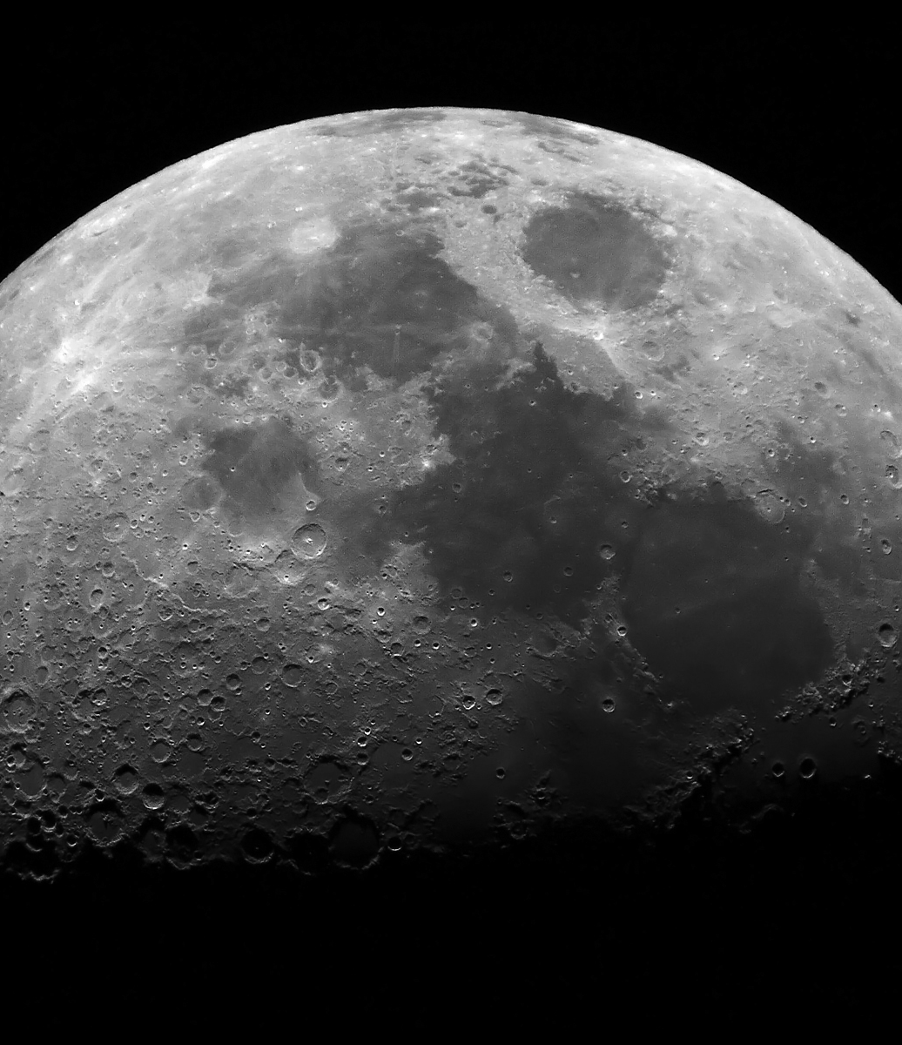
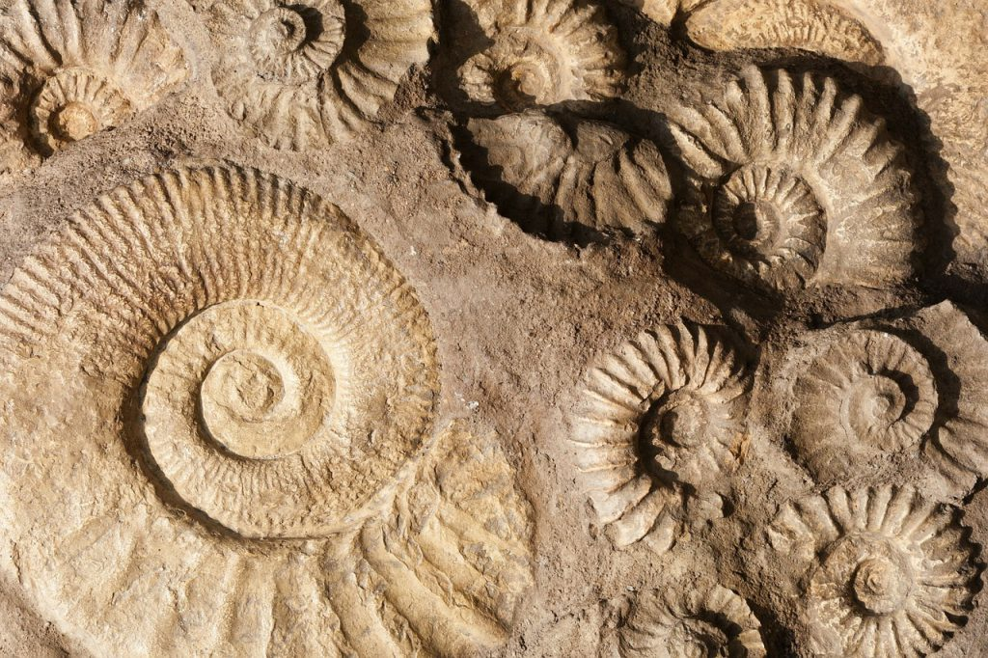
Moon
Earth’s Moon
Have you gone fossil hunting through the coulees of Alberta’s badlands and ready for the next challenge? Try the Moon! Asteroid impacts over millions of years have likely flung a great deal of material into orbit including the remains of ancient animals. With not atmosphere to speak of, the Moon is a great place to preserve these objects!
Are you going to be the Moon’s first paleontologist?
Bibliography
http://www.native-languages.org/komorkis.htm
https://solarsystem.nasa.gov/moons/earths-moon/overview/
https://www.cnet.com/news/china-moon-rover-to-investigate-cube-shaped-mystery-house-object/
https://www.newscientist.com/article/dn25961-ancient-earth-fossils-could-be-found-on-the-moon/
English
French
Blackfoot
Lune
Komorkis

Slide 2
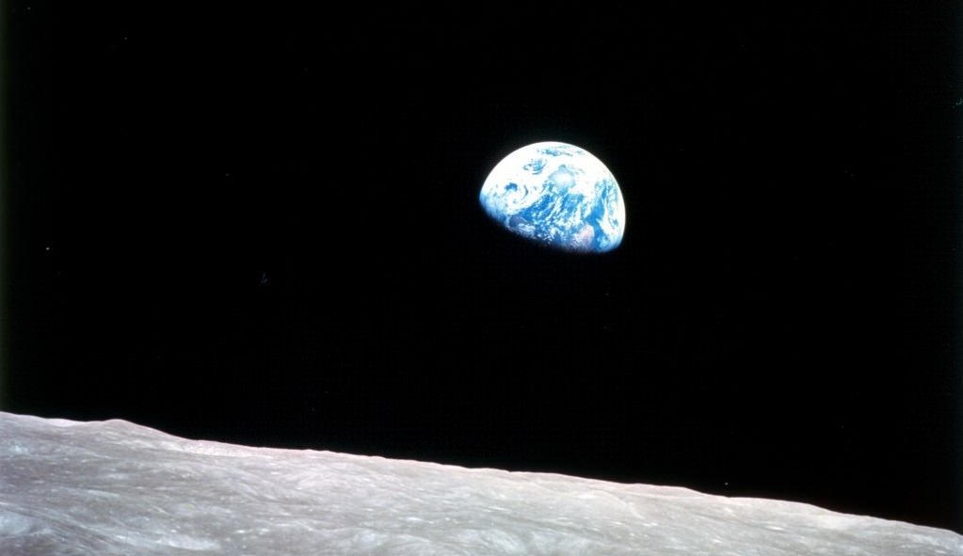
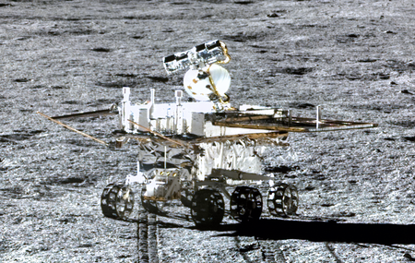
What you need to pack:
Luna – Earth’s first defense
As you travel the Moon’s surface an explore its craters, remember: Most those craters were made by objects headed for us! This lovely but desolate world has defended since before Tyrannosaurus Rex roamed the Earth!
Day Trips
As long as we’re landing at one of the poles or craters that has frozen water, we’ll need to bring almost everything we need:
Water
Food
Energy for heat and electricity as well as fuel to get home!
Apollo Missions
Explore the Apollo moon landing locations and see where the first humans took their first steps on a different world!
*Gift Shop closes at 1PM EST on Fridays
Yuta Mysteries!
Take some time to travel with the Chinese Yuta rover as it explores the far side of the moon! No Transformers over here, just one amazing robot!
Come for the science, stay for the Earth rises!
This Photo by Unknown Author is licensed under CC BY

